Slide 1
AI for Earphone Shape Design
Knowledge
find evidence
Knowledge, tools, and human reviews in the earphone design loop
Review
Generate
record lessons
explore ideas
Execute
operate tools
Focus: AI participation, process iteration, and lesson reuse
Notes:
We use a product design case to study how AI takes part in design tasks, and what reusable method each revision left behind. The case covers the earliest trial through the current candidate, organized in five stages. Knowledge retrieval supplies references, generation tools help compare concepts, execution tools perform the operations, and people together with check tools review the results. Design review and lesson write-back run through all of these steps. The report focuses on how AI participates, how the process changed, and what was verified.

Slide 2

Concept Image Inputs, Evidence, and Drawing Plan
Using the Fin Wing direction as an example, this shows how user needs become an executable generation Prompt.
User input
In-ear, comfortable, biomimetic, moderate size; stable in sport, stays on in sleep, youthful colors.
Split into product form, use scenarios, and look preferences; comfort and stability remain goals to verify.
1 RAG evidence
2 Drawing plan review
3 Assemble the Prompt
Real keyword search returned 4 cases
Summarized from the archived Prompt
Summary of the original English Prompt
In-ear, comfort, low profile, soft hold
Fin Wing: oval body + wide soft fin
One left earbud, 3:2 concept board
Oval body + short wide rounded fin
Blue-gray shell + teal matte soft gel
Shared parts, joints, size, occlusion
TOP oblique view, no tall hook or grid
Huawei ear-clip: hard/soft split
Blue-gray shell + teal matte soft gel
Vendor data; cross-form materials
Assumed: soft fin support limits bulge
QuietOn sleep plugs: low profile
Left ear, short-neck tip, shared parts
Vendor data; low volume limits features
Left worn, center four views, right hero
4 Image tool run and review
Tool renders the Prompt; six candidates are checked for consistency, then a person selects.
Candidates: Seed Pod, Pebble, Fin Wing, Spiral, Bloom, Twin Petal.
Check: left-ear side, joints, materials, and views; deviations go back into the Prompt.
Retrieval and Prompt are archived; data-to-parameter bindings were not saved, so the drawing plan is a review summary.
Notes:
This slide takes the user's needs as the example and expands product form, use scenario, and aesthetic preference into execution inputs. The archived real-keyword retrieval for the same needs returned four candidates: the Huawei ear-clip case provides the vendor's description of the hard/soft split, and the QuietOn sleep plugs provide the vendor's description of low protrusion and the trade-off between features and volume; both are kept separate from in-ear performance validation. The Fin Wing plan in the figure is reconstructed from the original generation Prompt and specifies the oval body, the short wide rounded soft fin, the blue-gray hard shell, the teal matte soft gel, the same left ear, shared components, and the required views. The item-by-item binding of data to each drawing parameter was not saved, so the continuous decision log of that time cannot be recreated. The existing results cover six directions. The image tool and RAG are separate steps; after rendering, the ear side, joints, materials, and views still need checking before a person selects. The original retrieval and the full English Prompt are archived; comfort, stability, and engineering dimensions remain to be validated.QuietOnPromptRAGPrompt

Slide 3
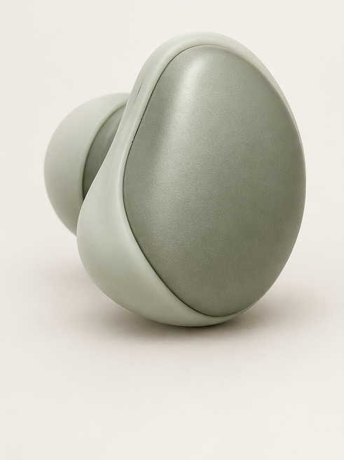




Design Features and Six Concepts
Seed Pod
Pebble
Fin Wing
Concept 1
Concept 2
Concept 3
Shallow saddle soft support
Rounded low profile
Short wide soft fin
Spiral
Bloom
Twin Petal
Concept 4
Concept 5
Concept 6
Shallow curled surface
Petal soft-gel wrap
Overlapping twin shells
Six left-ear concepts demonstrate this round's generation flow.
Input features set the generation direction. People compare and select.
Notes:
The same needs can generate several concept strategies for people to compare outlines, support methods, and hard/soft splits. The six left-ear concepts are Seed Pod with a shallow saddle soft support, Pebble with a rounded low profile, Fin Wing with a short wide soft fin, Spiral with a shallow curled surface, Bloom with a soft-gel petal wrap, and Twin Petal with overlapping twin shells. They demonstrate this round's generation flow and have not yet been selected. Volume, comfort, and stability have not been tested, and later selection must keep checking these requirements. Other input features can produce other concept directions.

Slide 4

Consistency Rules for Concept Images
Side, layout, and part relations are written into the generation spec, read by templates, RAG prompts, and tests.
Left ear only
Original orientation kept
Six-panel layout
Worn / four views / hero
No other panels are kept
Consistent across views
Shared proportion, joints, materials
Next-round entry points
Spec, references, prompts, tests
Consistency rules apply to new concepts. Form, color, and material follow the task.
Notes:
Side, layout, and shared part relations are written into the concept-image generation spec, which is read by the template, the current reference list, RAG prompts, and tests. The current case uses the left ear only and keeps the original orientation, with a six-panel layout: worn view on the left, four views in the center, and the hero image on the right. The four views are side, front, rear, and an angled top view, and only these panels are shown. All views share proportion, joints, and material split, and the review checks each item for consistency. New tasks reuse the consistency check method; form, color, and material are decided by the task, and if the user chooses another side, the new choice applies.

Slide 5
Questions on AI Collaboration
A continuous design task records AI participation, change feedback, and review results.
Four questions to answer
Methods and their evidence
Is there traceable evidence?
Methods added
Knowledge retrieval, concept-first, tool links
Can it run real tool operations?
Process evidence
History images, operation logs, rules, code
Can it locate errors and fix them?
Can the next round read past lessons?
Result checks
Save and reopen, shape checks, user review
Lesson reuse
Update workflow and entries, then regression-test
Unit of observation
Feedback, changes, reviews
Case observation checks the process. Gains still need controlled validation.
Notes:
This study is organized around four questions: can design evidence be traced, can AI operate real tools, can it locate and fix errors, and can existing lessons be read by the next round. We use feedback, changes, and reviews as the unit of observation, and compare them against the history images, operation logs, rules, and code left by knowledge retrieval, concept-first work, and tool connections. Result checks include reopening after save, shape checks, and user review. Lesson reuse requires updating the workflow and the run entry points, then running regression tests. So far we have process records from a single case. Control groups, efficiency metrics, and wear tests are still pending, and any gains need later controlled validation.

Slide 6
Design Task Execution and Review Flow
AI analyzes needs and runs the task. People review concepts, major changes, and deliverables.
Input: user description, confirmed constraints, current project state
Structure needs
Find evidence
Idea
Human: select
Traits / conflicts / gaps
Sources and limits
Comparable options
Concept / side / views
Output: needs table
Output: traceable reference pack
Output: concept board
Output: single current reference
Form and model
Run real tools
Geometry review
Accept
Parts / ratio / fit
Model / save / reopen
Geometry / angle / limits
Output: checkable CAD
Output: saved-state receipt
Output: issue list and evidence
Release on acceptance
On a failed review, locate, fix, and recheck. Write back lessons at task close.
Each round first checks the tool connection and resumes after it is restored.
Notes:
A design task starts from the user description, confirmed constraints, and the existing project state. AI organizes features, conflicts, and unknowns into a needs table, then retrieves references that carry their source and applicable limits, and generates several comparable concept directions. After a person confirms the concept, side, and views, AI analyzes parts, proportions, and attachment, then performs modeling, saving, and an independent reopen. Geometry and visual review produce an issue list and a receipt, and a person accepts the results within that scope. Failed items are traced to a specific step, fixed, and rechecked; release happens only after acceptance. Each round first verifies the current tool connection, and general lessons are updated when the task closes.

Slide 7
Feature Extraction from User Descriptions
AI extracts design features from the description, retrieves data by need dimension, and organizes candidates.
Natural-language description
Split need dimensions
Retrieve and combine
Problem, context, preferences
Form / scene / function / look
Query per dimension, then combine
Example input:
Mark constraints, conflicts, open items
Deduplicate, keep uncovered items
in-ear, stable in sport and sleep, youthful colors
Sleep is a scene. In-ear is a form
Lexical and semantic search keep sources
Hard constraints
Soft preferences
To clarify
Limits that must hold
Used for ranking options
Ask when sizes are missing
Trial result
After deduplication, two different products cover more needs
Dimension split and coverage selection passed an independent trial. Not yet integrated into the main project. Wear performance untested.
The example shows the method. Users still confirm constraint strength and priorities.
Notes:
Feature extraction works from the user description, and the input can be swapped for other needs or product tasks. In-ear, stable in sport, stays in during sleep, and youthful colors is a demo input, where in-ear describes form and sleep describes a scene. AI splits the needs by form, scene, function, and appearance preference, marks hard constraints, soft preferences, conflicts, and items to clarify, and asks for confirmation when sizes or priorities are missing. Retrieval queries by dimension, combines complementary references, deduplicates products, and records uncovered items. Both lexical and semantic retrieval keep their sources. An independent trial used deduplication to choose two different products that cover more needs. Dimension splitting and coverage selection are not yet automatically integrated into the main project. Wear performance is untested, and constraint strength and priorities are still confirmed by the user.

Slide 8
RAG Knowledge Retrieval and Design Evidence
RAG (retrieval-augmented generation) reads product cases, ear data, and tool docs to ground the design.
Design data: trade-offs
Ear data: constraints
Tool data: operations
Product cases, images, feedback
Ear regions, sizes, contact limits
FreeCAD docs, modeling, checks
Structure, support, materials
Placement and fit. Comfort untested
Guides operations and checks
Main evidence retrieved for this case
Separate knowledge base, chosen per task
Retrieved apart from product design data
How retrieved data supports design decisions
Small-volume cases: fewer functions, simpler structure
Record advice, evidence, open items
Soft-support cases: hard shell vs. contact parts
Which features to borrow, and from where?
User feedback: charging, controls, long-term trade-offs
Which sizes and wear performance lack evidence?
References include QuietOn, Kokoon, Ozlo, and Nothing Ear, each with source type and applicable limits.
Retrieval relevance and source credibility are assessed separately
Notes:
RAG stands for retrieval-augmented generation. It brings retrieved material into the current task so that AI can make design suggestions with sources. Here we use three separate knowledge bases: product design, ear anatomy, and tools. Product cases, image observations, and user feedback provide references for structural trade-offs, support methods, and material expression. Ear data provides position, size meaning, and contact constraints. FreeCAD documentation helps choose modeling and check operations. In this case, small-volume products supported function and structure trade-offs, soft-support cases helped separate the hard shell from contact parts, and user feedback added charging, control, and long-term use issues. References include QuietOn, Kokoon, Ozlo, and Nothing Ear, and each suggestion keeps its source type, applicable limits, and open items. Retrieval relevance and source credibility are judged separately, and real comfort still needs wear trials.

Slide 9
Evidence Review of Retrieved Data
Review source, visible facts, and inference to decide which design conclusions each item supports.
Source records
Image observation
Inference records
Vendor notes, reviews, user feedback
Outline, material zones, accessory relations
AI inferences recorded separately
Keep author and source category
Sizes and use effects need other evidence
Unsupported conclusions marked as open
Review flow before data enters design
01 Verify source
02 Match purpose
03 Keep open items
Check original text and image source
Shape reference or support data
File inference apart from source text
Record author and conditions
Sizes must map to a specific part
Not modeled on weak evidence
An independent trial reviewed 166 images: 119 as shape references, 47 as support data.
Comfort, sport stability, and retrieval quality gains still need separate validation
Notes:
Evidence review records sources, image observations, and AI inferences separately. Vendor notes, independent reviews, and user feedback keep the author and source category. Images can support observations of outline, material zones, and accessory relations, while sizes and use effects need matching evidence. Before data enters the design, we verify the original text and image source and record the applicable conditions, then separate shape references from support data by purpose, and sizes must map to a specific part. Inferences are filed apart from the source text, and conclusions without evidence are marked as open and not yet used for modeling. An independent trial reviewed 166 images one by one: 119 were classed as shape references and 47 as support data. Comfort, sport stability, and retrieval quality gains still need separate validation.

Slide 10
MCP Tool Calls and Result Checks
MCP connects tools, RAG provides evidence, and people review scope and results.
Knowledge, confirmed project state
Tool interfaces and scope
Scope and protections
AI executor
Headless: docs, scripts, export
Human
Static script check, isolated process, result check
needs / review
Plan tasks, pick tools, check
CAD GUI bridge: read / limited edits
GUI prototype supports verified operations only
Restore a failed tool link first
Real window and document still checked
Result review flow
Save file
Reopen
Shape check
A/B receipt and human review
Failed checks return to execution. Major trade-offs return to design review. People accept the final result.
Interfaces split work by verified capability. Actual files are checked after each operation.
Notes:
MCP connects the tools, RAG provides design evidence, and people review the execution scope and results. AI combines the confirmed project state to organize tasks, choose tools, and check receipts. Tool paths include headless document, script, and export operations, plus the existing CAD GUI bridge; the GUI prototype supports only its verified operations, and the current task still confirms the actual window and document. Scripts are checked before execution, run in an isolated process, and their results are verified afterwards; if the connection fails, it is restored first. After a file is saved it is reopened independently, geometry and visuals are checked, and a comparison receipt is produced for human review. Failed checks return to execution, major design trade-offs return to design review, and a person accepts the final result. Different interfaces divide the work by their own verified capabilities.

Slide 11

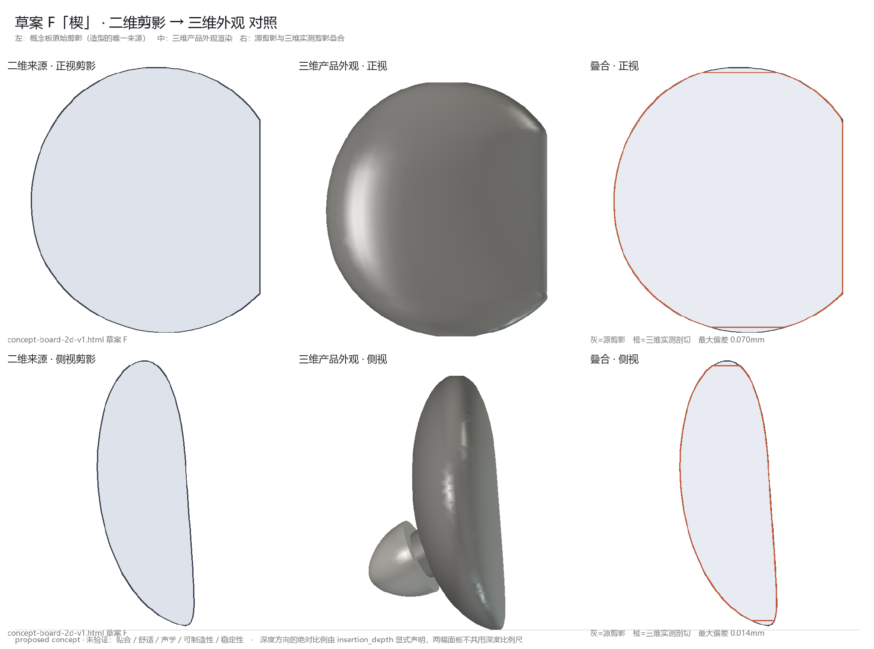

Growth of AI Collaboration: Stages 1 to 3
Concept images come first. Choose the direction, then turn the concept into an editable 3D model.
1 Rough geometry
2 2D first, then translate
3 Concept and 3D review
Concept front
Model front
Early trial: geometry, thin evidence.
Early 2D outline excerpt. Concept fixed first.
Newer method: one-reference check.
Skill
Needs to rough geometry
Skill
Compared 2D concepts
Skill
Editable 3D concept
Gap
Modeling lacked evidence
Gap
No concept guidance
Gap
Wrong-face circling risk
Step
Concept first, human pick
Step
Concept first, then lock
Step
Relabel, check sections
Gain
Set direction, then model
Gain
Chosen concept to 3D
Gain
Feedback now checkable
Six stages grouped by capability. Methods refine each other. Candidates still await review.
Notes:
Early on, AI could turn need words into rough geometry, and direct modeling exposed the lack of form evidence. Concept-first put ideation, 2D expression, and human selection before modeling, locking the design intent first. The gap at the second node was an editable 3D model, so the next stage had to turn the chosen concept into editable CAD geometry. Once the model existed, the concept and the saved model could be checked item by item, while occlusion ambiguity in circled feedback still needed later spatial diagnosis. The early 2D outlines come from the real archive; the later joint-review image is an example of a newer method, and the candidate still awaits review.

Slide 12



Growth of AI Collaboration: Stages 4 to 6
Real sections and ear-region knowledge aid placement. Whole-unit moves and review write-back support later tasks.
4 Circling and sections
5 Ear-region placement
6 Joint wear and review
Entry
Near soft leaf
Before
After
Cymba concha
upper concha
Crus of helix
helix root
Cavum concha
Ear
Tip
Nozzle
Leaf
lower concha
Real sections, equal scale.
Names, map, and real source faces match.
Real saved state, same-camera A/B.
Skill
Sections show depths
Skill
10 regions map to faces
Skill
Direction partly confirmed
Gap
Ear names not on model
Gap
Local fixes hid bad pose
Gap
Joint and wear untested
Step
Map bound to CN/EN names
Step
Align ears, move as unit
Step
Review, A/B, write-back
Gain
Feedback on ear regions
Gain
Fit targets guide pose
Gain
Traceable, gaps logged
Ear regions and sections support position checks. Wear and cross-task effects are still under validation.
Notes:
Real sections help verify part layers and distances; the two images excerpt 635 independent section lines, each shown at equal scale. Once the ear-region names in Chinese and English, the map, and the real source faces are bound together, feedback can be placed on the model. When the overall pose is wrong, the whole unit and its parts move together, so local deformation stops compensating for layout errors. The saved-state A/B in the image keeps the same camera; the partial confirmation of the unit direction covers only that judgment, and joint, support, and real wear still need validation. Methods that pass review, failure causes, and applicable limits are written back to the workflow and the execution entry points, and cross-task effects keep being checked.

Slide 13
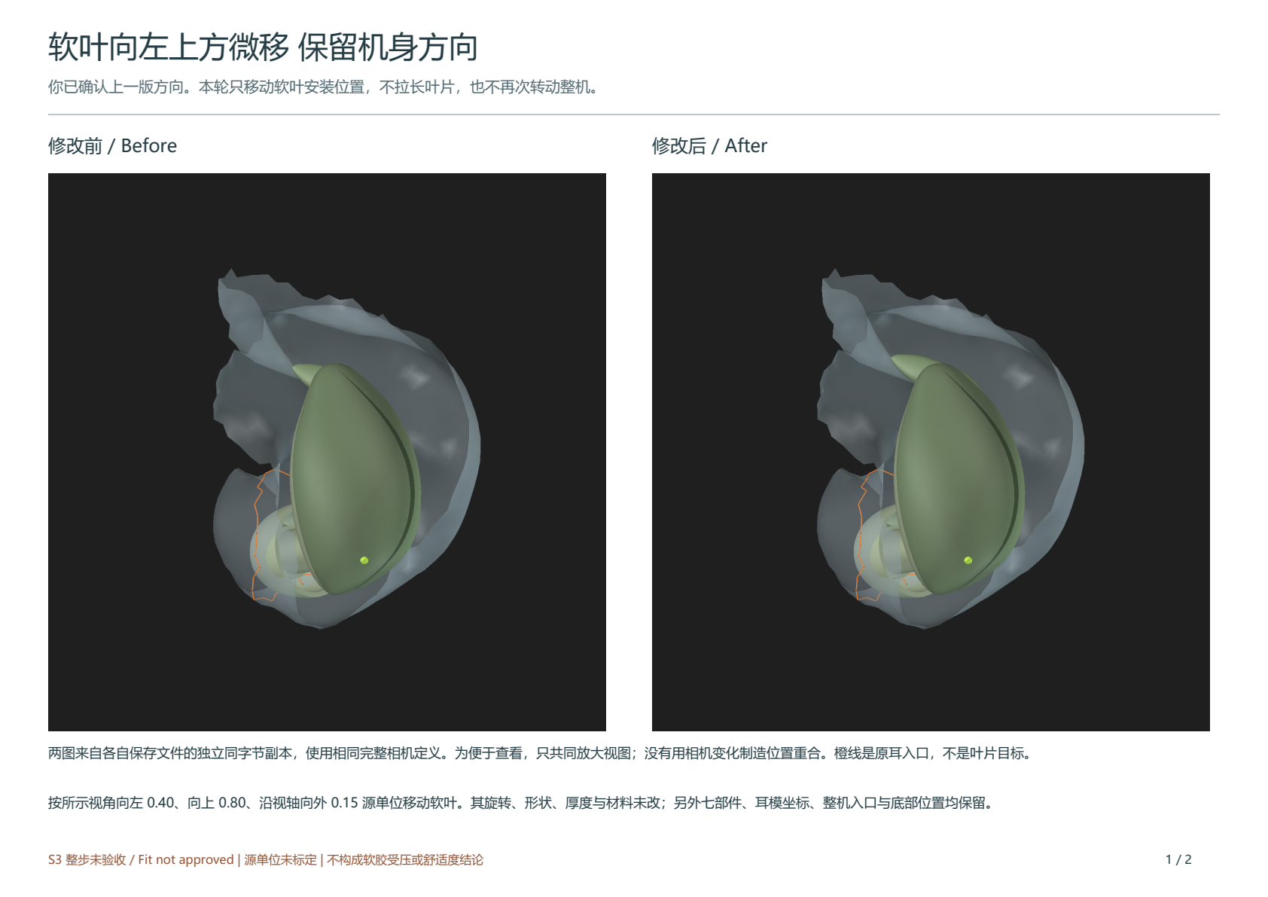
How Review Results Enter the Next Round
Changes run after the plan is confirmed, same-version receipts support human review, and rules re-enter the workflow.
Receipt of a soft-leaf nudge
Human feedback
AI restates plan
Human confirms
Describe, mark, goal
Edits and protections
Scope and trade-offs
Human reviews
Make A/B receipt
AI applies edit
Accepted scope, gaps
Same-setting A/B PDF
Save and fresh reopen
Accepted scope and open items are logged separately; failed items are reworked.
After write-back, check the actual reads
Workflow and project memory
Prompts, templates, tool entries
Known pass/fail cases and next task
Accepted scope and gaps are recorded separately; after write-back, check actual reads and regression.
Notes:
Each change starts with human feedback. AI restates the goal, the plan, and the protected items, and implements only after confirmation or under explicit prior authorization. The file is saved and reopened independently, and a same-condition A/B PDF is provided for human review; the accepted scope and unresolved items are recorded separately, and anything that fails is reworked. The right side keeps the actual receipt of one soft-leaf nudge, used only to show the review scope of that change. Effective methods and failure boundaries go into the workflow, project memory, generation prompts, templates, and tool entry points, and known positive and negative cases plus the next task are used to check that they are actually read. Specifications, tool implementation, tests, and migration are tracked separately; write-back does not mean model parameter training or overall product acceptance.AIA/B PDF

Slide 14
Progress and Next Validation
Process evidence supports method checks. Cross-task reuse and product performance still need validation.
Used in the main project
Independent trial results
Open questions
RAG, concept-first, tool runs
Form/scene split, coverage pick
Efficiency and quality gains
Reopen, receipts, write-back
Image purpose, size attribution
Comfort, stability, production
Records checkable, product pending
Not yet fully in the main automatic path
Controls and tests still needed
Validation plan for the next round
New needs and product task
Log errors, rework, data gaps
One-standard controls
Check extraction and rule reuse
Track rule reads and failures
Wear tests, engineering tests
Product: pose refinement paused, joint under review, multi-view regression pending, gaps kept.
Method use, user acceptance, product performance, and cross-task validation are recorded separately
Notes:
The main project already uses RAG retrieval, concept-first work, tool execution, save-and-reopen, review receipts, and lesson write-back, and the process records can be checked. Form and scene splitting, need-coverage selection, and the review of image purpose and size attribution have independent trial results but are not yet fully on the main project's automatic path. Causal gains in efficiency and design quality, plus real comfort, stability, material, and manufacturing performance, still need validation. The next round can switch the needs and product task, check feature extraction and rule reuse, log errors, rework, and data gaps, track rule reads and failures, run controls with one standard, and then run wear and engineering tests separately. Pose refinement is paused for now, the joint candidate awaits review, later multi-view and form regression are pending, and earlier gaps are kept. Method use, content acceptance, product performance, and cross-task validation each record their own results.

